Slide 1
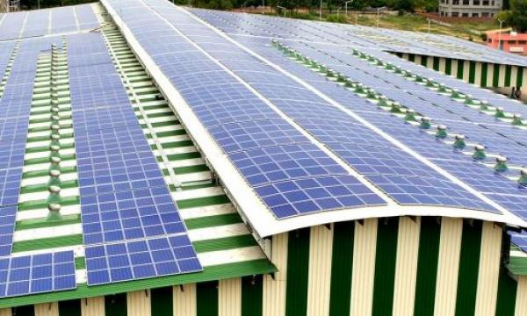
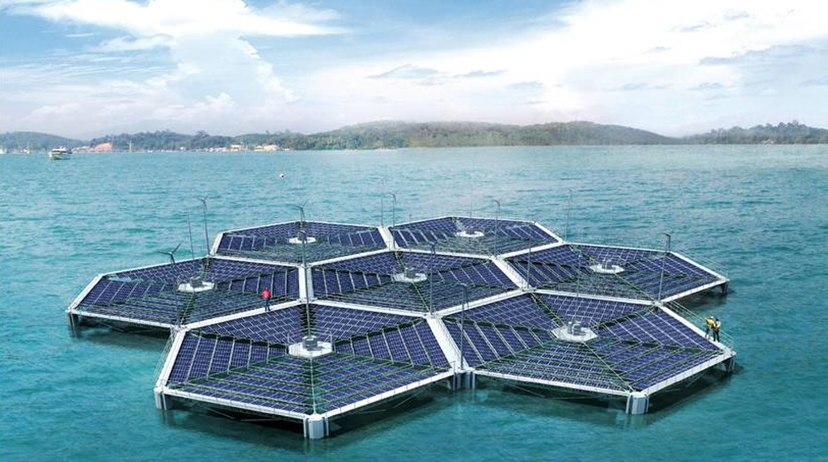
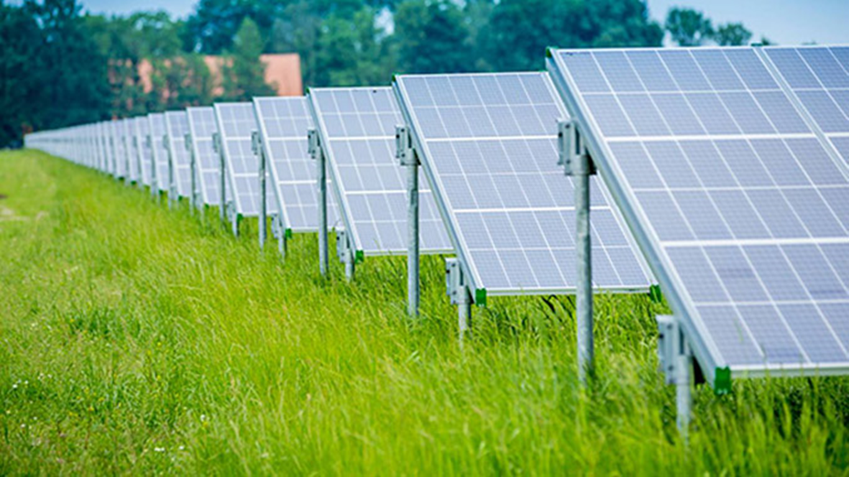
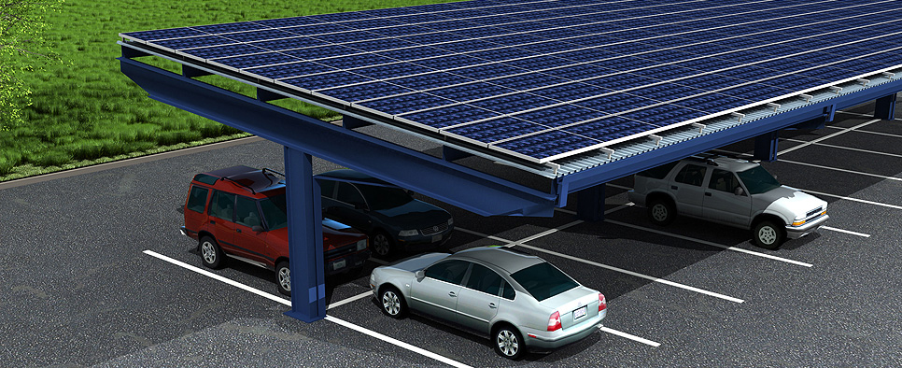
Application
Rooftop
Water
Land
Carport

Slide 2




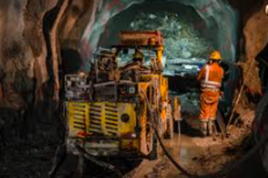

Which Business Can benefit ?
Automobile
Food & Beverage
Textile
Industrial
Mining
Commercial

Slide 3
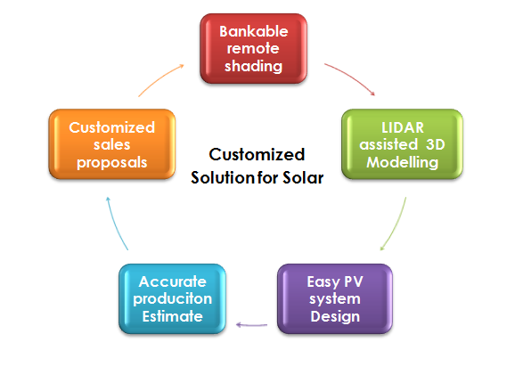
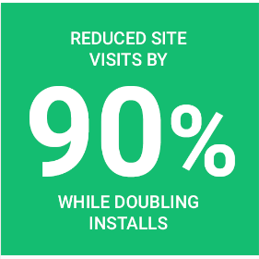
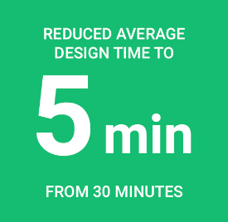
Customized Solution for Solar

Slide 4
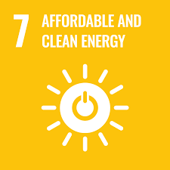

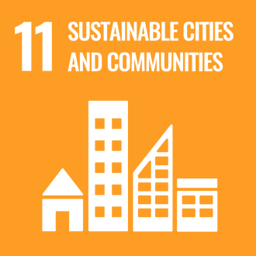

NexGen projects support the UN Sustainable Development Goals (SDGs)

Slide 5
Investor
NexGen Solar
Energy Customer
PPA Agreement
Principal plus Interest
PAY AS PER TARIFF
Lend Money

Slide 6
Benefits for Investors
We utilize our expertise, network and technology to screen through the noise
Healthy Return Potential
Tangible Asset Ownership
Experienced Team

Slide 7
3 Easy Steps of Investing
Choose an investment project
1
Lend money to the particular Project & Track performance
2
Get your money back plus interest
3

Slide 8
Benefits for Energy Customers
We understand your power needs. Our Cross-Sector experience gives us the ability to offer you Tailored Solutions and Pricing.
Operational Expenditure
Better than Market Rate
Transfer Opportunities

Slide 9
3 Easy Steps to Project Funding
Send Project details & Screen
1
Review and Pricing
2
Agreement & Signoff
3
Sustainable and ethical investments that empower you to fight climate change

Slide 10

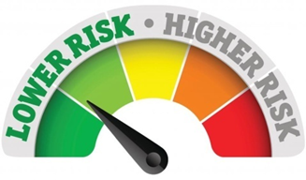

Benefits of Managed Portfolio
Managed Portfolio is the easiest way to fill a gap in your portfolio with private renewable energy investments
Portfolio Diversification
Lowering Risk
Cash flow
Benefit from investment opportunities across different states and asset types in the one of the top emerging country
Invest in multiple assets at a substantially lower minimum compared to investing in individual assets.
Renewable energy investments are annuity style investments. The cash flow is locked in typically over 7 to 20 years

Slide 11
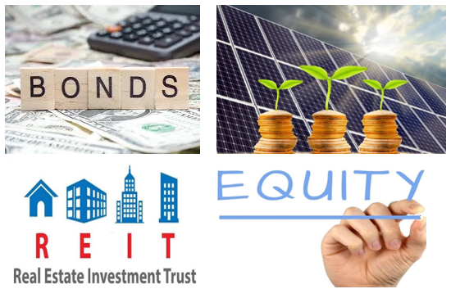
What makes Renewable Energy Assets unique?
We help you diversify your asset allocation with private renewable energy assets to create a more efficient portfolio and improve your risk-adjusted returns.
Less Volatile
Low Return
High Return
More Volatile

Slide 12
The Benefits of Investing with NexGen Solar
15%+
5 - 20 years
5 - 6 years
2.1- 3.5X +
Net IRR for medium to large scale solar rooftop or Ground mount projects
Tenure of Investment
Break Even Period
Target total return

Slide 13



Impact Investing
Investing with NexGen Solar is an opportunity to have a meaningful impact in the real world.
Developing Economy (GDP growth is approx 7-8%)
Environment Friendly
Aligned with UN SDGs
We focus on investments in solar rooftop, which enables traditional industries to change their power source to clean energy.
We meet the criteria for multiple UN Sustainable Development Goals by helping investors invest in public goods.
We focus on investments in India where access to capital for renewable energy is low

